Slide 1
Agile Planning & Estimation
Aruna Kumbhar

Slide 2
Revise
Classification of Agile Methods
Agile Teams
Agile Team Meetings
Agile Methodologies – Scrum, XP, FDD, Crystal, Kanban, Adaptive Software Development (ASD), Lean

Slide 3
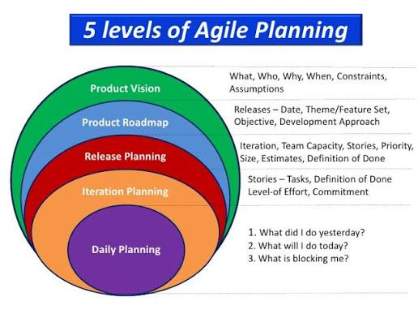
"If our class is planning a Goa trip, do we decide everything on the first day?"
The planning happens in stages:
First decide where to go
Then decide how to travel
Then decide what to pack
Finally decide what to do today
Software projects work exactly the same way
Agile follows multiple levels of planning, not one huge plan

Slide 4
1. Vision Planning (The Big Dream)
What are we building? Why are we building it?
College Management System – We are developing a system where students can register, pay fees, check attendance and view results
2. Roadmap Planning (The Journey)
What major features will be built over the coming months?
Month | Feature
Month 1 | Student Login
Month 2 | Attendance
Month 3 | Fee Payment
Month 4 | Examination Module

Slide 5
3. Release Planning
Which features will be included in the next software release?
Example: Release 1.0
Login
Registration
Attendance
4. Sprint Planning
What can we complete in the next 2 weeks?
Suppose the Product Backlog contains
Login
Attendance
Reports
AI Chatbot
Fee Payment
The team selects only
Login
Attendance

Slide 6
5. Daily Planning (Daily Scrum)
Every morning, the team meets for about 15 minutes and answers:
What did I complete yesterday?
What will I do today?
Is there any blocker?
Vision
│
Roadmap
│
Release Plan
│
Sprint Planning
│
Daily Planning

Slide 7
Estimation Technique in Agile
Estimation is the process of finding an estimate, or approximation. It is an Art of guessing.
Estimation includes four main factors - money, effort, resources, and time needed to build a specific system or product.
Agile Uses Relative Estimation Technique
Relative Estimation
Relative Estimation means comparing one task with another to estimate its effort, instead of predicting the exact time required
How many minutes will it take you to travel to college tomorrow? Can you answer exactly? But if asked, "Is going to Pune more difficult than going to the nearby market?“ then the answer is exactly yes
That's the idea behind Relative Estimation.

Slide 8
1. Dot Voting 🟢
Dot Voting is a simple technique where each team member gets a few dots (votes) and votes for the stories they believe are most important or need discussion.
It is often used during Backlog Refinement or Sprint Planning
Student Login ●●●●●
Attendance ●●●●
Fee Payment ●●●
Reports ●●
AI Chatbot ●
The story with the most dots gets higher priority or is discussed first
Your class is deciding which place to visit on a picnic.
Everyone gets three votes.
Destination with the highest votes wins.
That's Dot Voting

Slide 9
2. T-Shirt Size 👕
Instead of numbers, Agile teams sometimes estimate using clothing sizes
Size | Meaning
XS | Very Easy
S | Easy
M | Medium
L | Difficult
XL | Very Difficult
Feature | Size
Login | S
Registration | M
Attendance | M
Fee Payment | L
AI Chatbot | XL

Slide 10
3. Planning Poker 🃏
Planning Poker is the most popular Agile estimation technique.
"Estimate how difficult preparing for semester exams is."
Every team member gets cards with Fibonacci numbers on it 0,1,1,2,3,5,8,13,21….
One of the team members is selected as the Moderator. The moderator reads the description of the user story for which estimation is being made. If the estimators have any questions, product owner answers them
Each estimator privately selects a card representing his or her estimate
In the first round, it is very likely that the estimations vary. The high and low estimators explain the reason for their estimates
The team can discuss the story and their estimates for a few more minutes
After the discussion, each estimator re-estimates by again selecting a card
Repeat the process till the estimates converge to a single estimate that can be used for the story

Slide 11
4. Bucket System 🪣
Suppose you have 100 User Stories, Planning Poker would take a long time.
Instead, Agile teams use the Bucket System
Pick one story at a time. Place it into the appropriate bucket.
Bucket 2
Student Login
Faculty Login
Bucket 5
Attendance
Reports
Bucket 13
Fee Payment
Bucket 40
AI Recommendation Engine

Slide 12
5. Large / Uncertain / Small (LUS)
Sometimes teams don't need exact numbers. Instead they classify stories into three categories.
User Story | Category
Login | Small
Attendance | Small
Fee Payment | Large
AI Chatbot | Uncertain
Suppose your teacher gives three assignments.
One is familiar.
One is lengthy.
One has confusing instructions

Slide 13
6. Relative Estimation
This is the foundation of most Agile estimation techniques
Instead of estimating exact hours, compare one story with another
User Story | Relative Size
Login | 2
Registration | 3
Attendance | 5
Fee Payment | 8

Slide 14
7. Story Points ⭐
Story Points are the most common Agile estimation unit
Complexity: How difficult is the user story? Does it require a lot of steps to complete?
Risk: What are the potential risks involved? These could include uncertainty or dependence on a third party.
Repetition: How monotonous are the tasks? When a team member is familiar with certain tasks, the complexity and risk factors are reduced.
All of these elements must combine for accurate story point estimation

Slide 15
8. Estimation Based on Velocity 🚀
After several sprints, teams know how much work they usually complete.
This average is called Velocity
Sprint | Completed Story Points
Sprint 1 | 18
Sprint 2 | 20
Sprint 3 | 22
(18 + 20 + 22) ÷ 3 = 20 Story Points
Suppose the Product Backlog contains 100 Story Points
Average Velocity 20 Story Points per Sprint
Estimated Sprints 100 ÷ 20 = 5 Sprints

Slide 17
Agile Reports
After your exams, how do you know whether you have performed well or not?
Can a cricket team know if it is winning without looking at the scoreboard?
Similarly, an Agile team cannot know whether a project is progressing well without looking at Agile Reports
Instead of reading hundreds of tasks, Agile reports summarize everything using graphs and charts
Agile reports help answer questions like:
Are we on schedule?
Are we completing enough work?
Is the sprint healthy?
Where are tasks getting stuck?
Will we finish on time?

Slide 18
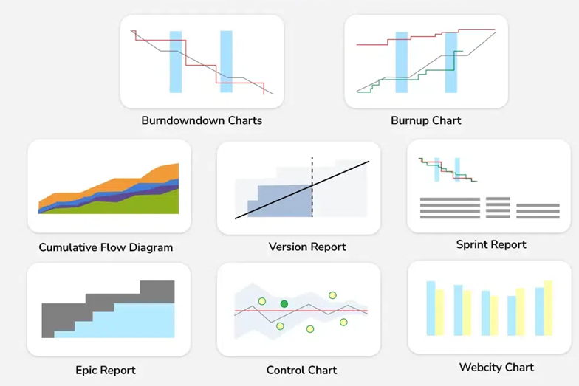

Slide 19
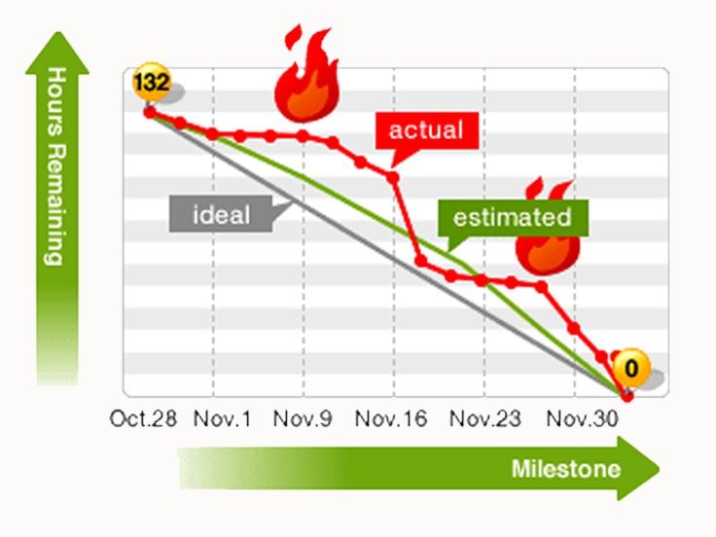
1. Burndown Chart 🔥
Shows- How much work is remaining in the current sprint

Slide 20
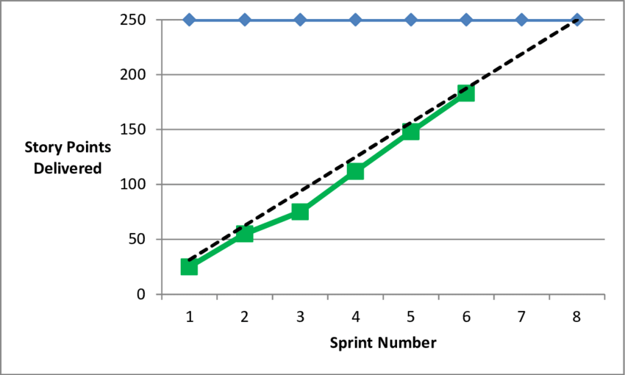
2. Burnup Chart 📈
Shows - Work completed and Total work. Both increase over time

Slide 21
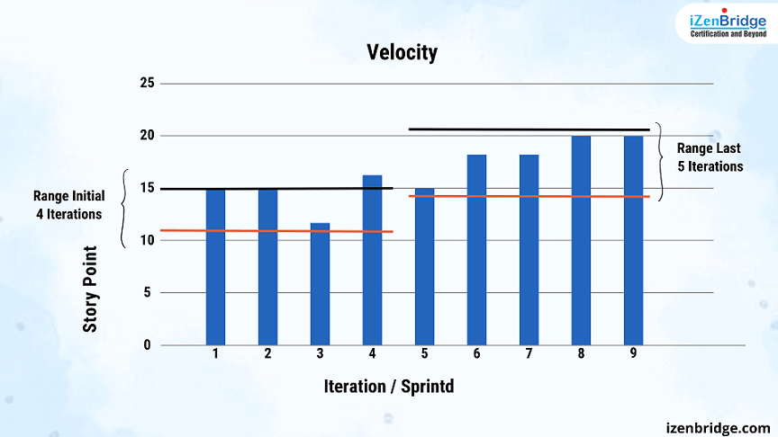
3. Velocity Chart 🚀
Shows- How much work the team completes in each sprint.

Slide 22
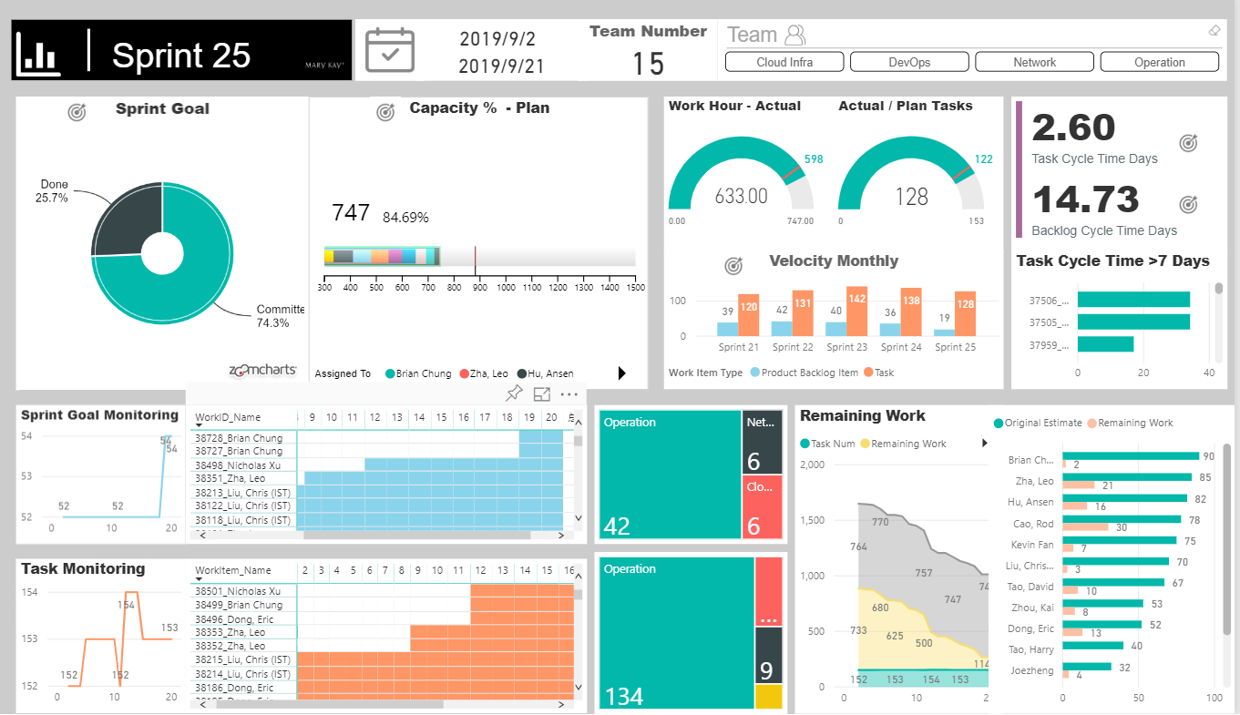
4. Sprint Report 📋
Shows- Completed work, Incomplete work, Added work, Removed work during one sprint.

Slide 23
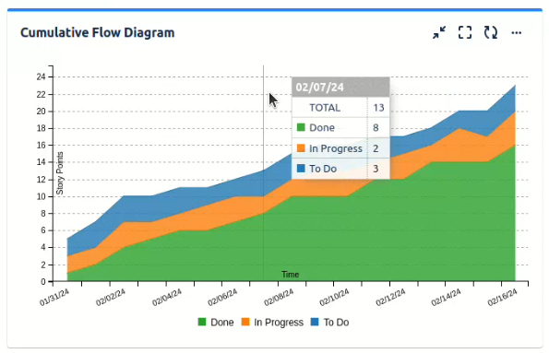
5. Cumulative Flow Diagram (CFD)
The CFD shows how work flows through these stages like To-Do, In Progress, In Review, Done

